Slide 1
Yanick A. Anagho
Data Science Immersive (DSI) Capstone Project – August 2021
User Ratings of Beauty Products on Amazon

Slide 2
Agenda
Audience
Question(s)
Data
Data Prep

Slide 3
My project will focus on consumer product ratings from the most popular e-commerce platform; Amazon. We will try to understand the user ratings of products on Amazon

Slide 4
Data Set
The dataset is a curated subset of data; user ratings of beauty products, from user reviews of products purchased on Amazon between 1996 and 2014.
A CSV file obtained from; https://code.datasciencedojo.com/datasciencedojo/datasets/tree/master/Amazon%20Product%20Reviews¹
This dataset also include metadata that further provides information on the user rated products
28 variables
371345 observations

Slide 5
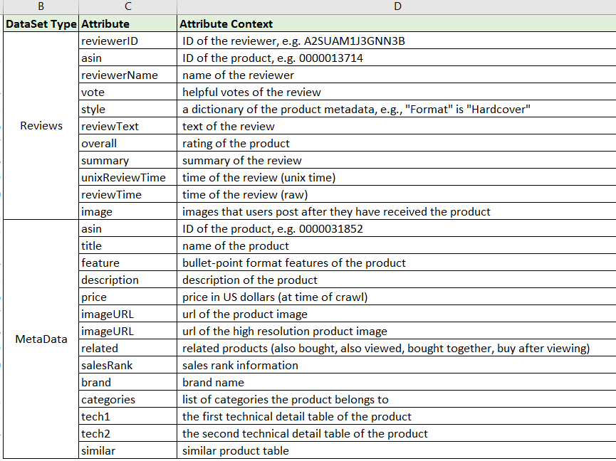
Data Dictionary

Slide 6
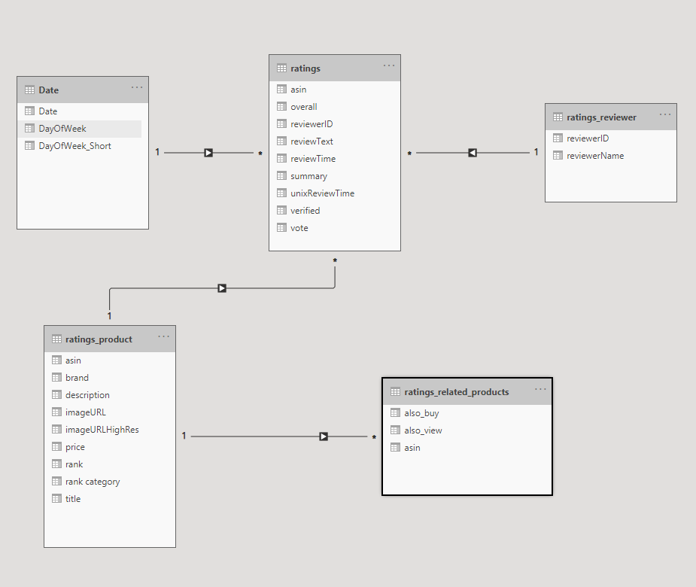
Data Model
Modeled into 4 related entities:
Ratings
Ratings_Product
Ratings_Reviewer
Ratings_related_products

Slide 7
Data Prep

Slide 8
Moving Forward
Explore data further (identify data story)
Narrow down to specific question(s) – possibly expand more attributes and reduce instances (columns and rows)
Statistics knowledge
Integrate other independent data linked to any attribute of existing dataset e.g. weather, labor etc.
visualizations

Slide 9
Sources
Ups and downs: Modeling the visual evolution of fashion trends with one-class collaborative filtering
R. He, J. McAuley
WWW, 2016
mcauley.ucsd.edu/data/amazon/links.html

